Slide 1
Casting Defects
The following are the major defects, which are likely to occur in sand castings
Gas defects
Shrinkage cavities
Molding material defects
Pouring metal defects
Mold shift

Slide 2
1-Gas Defects
A condition existing in a casting caused by the trapping of gas in the molten metal or by mold gases evolved during the pouring of the casting. The defects in this category can be classified into blowholes and pinhole porosity. Blowholes are spherical or elongated cavities present in the casting on the surface or inside the casting. Pinhole porosity occurs due to the dissolution of hydrogen gas, which gets entrapped during heating of molten metal.

Slide 3
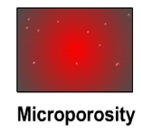
The lower gas-passing tendency of the mold, which may be due to lower venting, lower permeability of the mold or improper design of the casting. The lower permeability is caused by finer grain size of the sand, high percentage of clay in mold mixture, and excessive moisture present in the mold.
Causes
Metal contains gas
Mold is too hot
Poor mold burnout

Slide 4
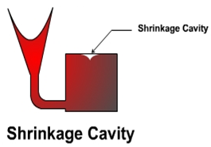
2- Shrinkage Cavities
These are caused by liquid shrinkage occurring during the solidification of the casting. To compensate for this, proper feeding of liquid metal is required. For this reason risers are placed at the appropriate places in the mold. Sprues may be too thin, too long or not attached in the proper location, causing shrinkage cavities. It is recommended to use thick sprues to avoid shrinkage cavities.

Slide 5
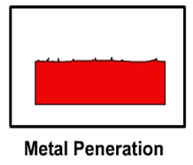
3----Molding Material Defects
The defects in this category are cuts and washes, metal penetration, fusion, and swell
3-1 Cut and washes
3-2 Metal penetration
These appear as rough spots and areas of excess metal, and are caused by erosion of molding sand by the flowing metal. This is caused by the molding sand not having enough strength and the molten metal flowing at high velocity. The former can be taken care of by the proper choice of molding sand and the latter can be overcome by the proper design of the gating system
When molten metal enters into the gaps between sand grains, the result is a rough casting surface. This occurs because the sand is coarse or no mold wash was applied on the surface of the mold. The coarser the sand grains more the metal penetration.

Slide 6
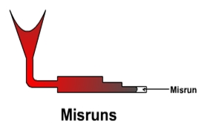
4---Pouring Metal Defects
The likely defects in this category are
4-1 A mis-run is caused when the metal is unable to fill the mold cavity completely and thus leaves unfilled cavities. A mis-run results when the metal is too cold to flow to the extremities of the mold cavity before freezing. Long, thin sections are subject to this defect and should be avoided in casting design.

Slide 7
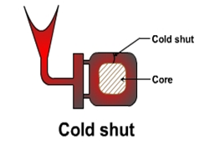
4-2 A cold shut is caused when two streams while meeting in the mold cavity, do not fuse together properly thus forming a discontinuity in the casting. When the molten metal is poured into the mold cavity through more-than-one gate, multiple liquid fronts will have to flow together and become one solid. If the flowing metal fronts are too cool, they may not flow together, but will leave a seam in the part. Such a seam is called a cold shut, and can be prevented by assuring sufficient superheat in the poured metal and thick enough walls in the casting design.
The mis-run and cold shut defects are caused either by a lower fluidity of the mold or when the section thickness of the casting is very small. Fluidity can be improved by changing the composition of the metal and by increasing the pouring temperature of the metal.

Slide 8
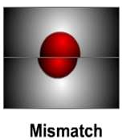
5---Mold Shift
The mold shift defect occurs when cope and drag or molding boxes have not been properly aligned.

